Slide 1
Automatic Umbrella System
Micah Oliveri-Schneider, Samuel Underwood, Brandon Nguyen
Notes:
Sam

Slide 2
Table of contents
01
02
03
04
05
Introduction
Implementation overview
Purpose and humanity efforts
What we did, our progress, fixing errors
AI Usage
Results
How we used AI during this project
How our prototype functions
Conclusion
Overview and Reflection
Notes:
Sam

Slide 3

Introduction
Purpose
Automatic umbrella
Rain intensity indicator
Humanity Efforts
Helps individuals who can't open their umbrella on their own.
Protects individuals from being soaked in rain.
Notes:
Brandon
To create an umbrella that opened using a humidity sensor instead of manual input.
Helps individuals who lack the ability to manually open their umbrella on their own.
Protects individuals from being soaked in rain which could lead to health concerns.

Slide 4
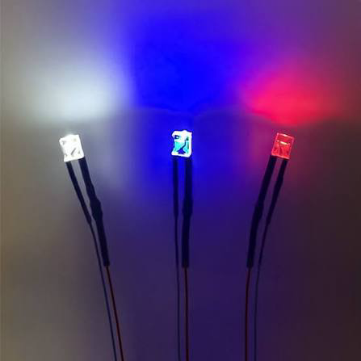
Inputs and outputs
Inputs:
Humidity sensor
Contact switch
Output:
Motor
Flashing LED

Slide 5
Constraints and Requirements
Constraints:
Limited to the materials offered such as cardboard and duct tape
Needed to create an umbrella light enough for the motor to move using the materials we had.
Requirements:
Needed humidity sensor, LED, and at least one other switch.
Use of AI code

Slide 6
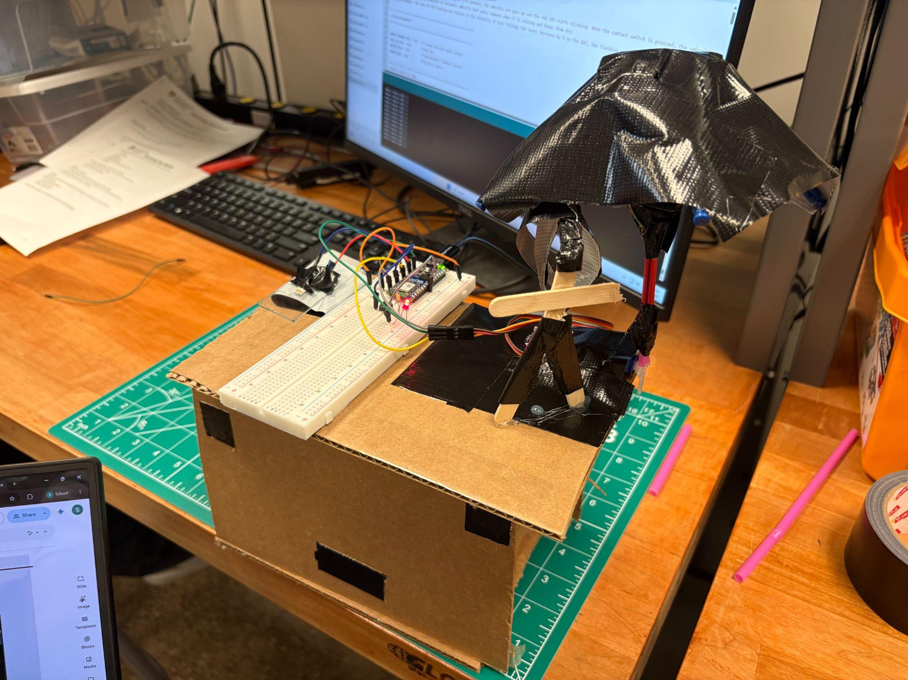
Implementation of Design Process
Research
Examined the basic design of an Umbrella so it could be recreated with present materials
Prototype
Utilized knex, duct tape, and servo motor for main umbrella component with our sensor connected to detect moisture.
Pictured Above is Prototype
Notes:
Sam

Slide 7
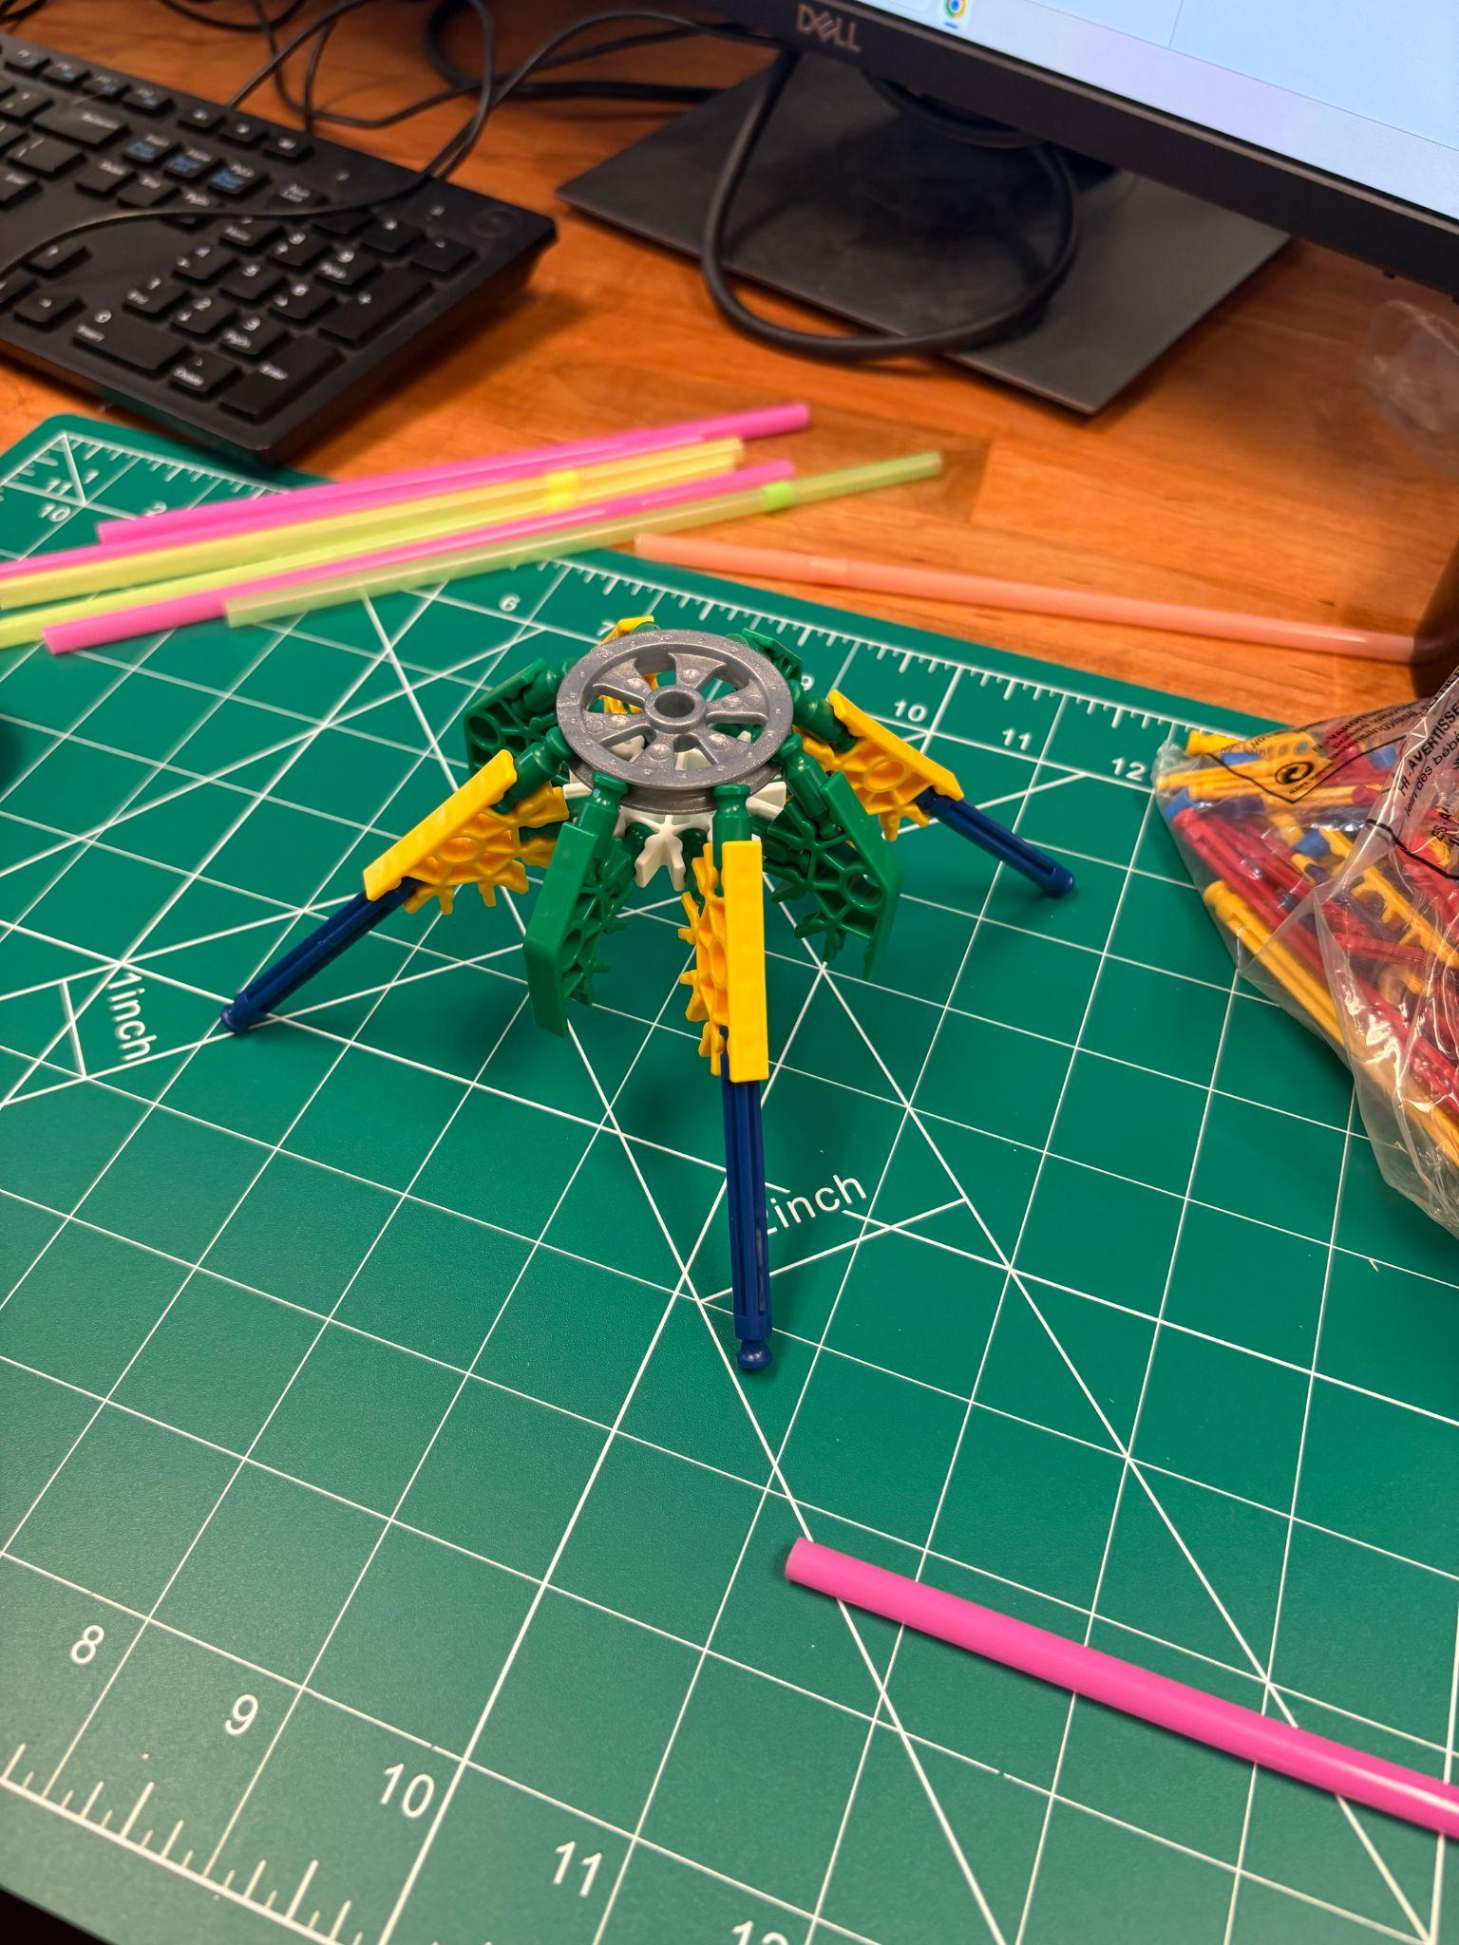
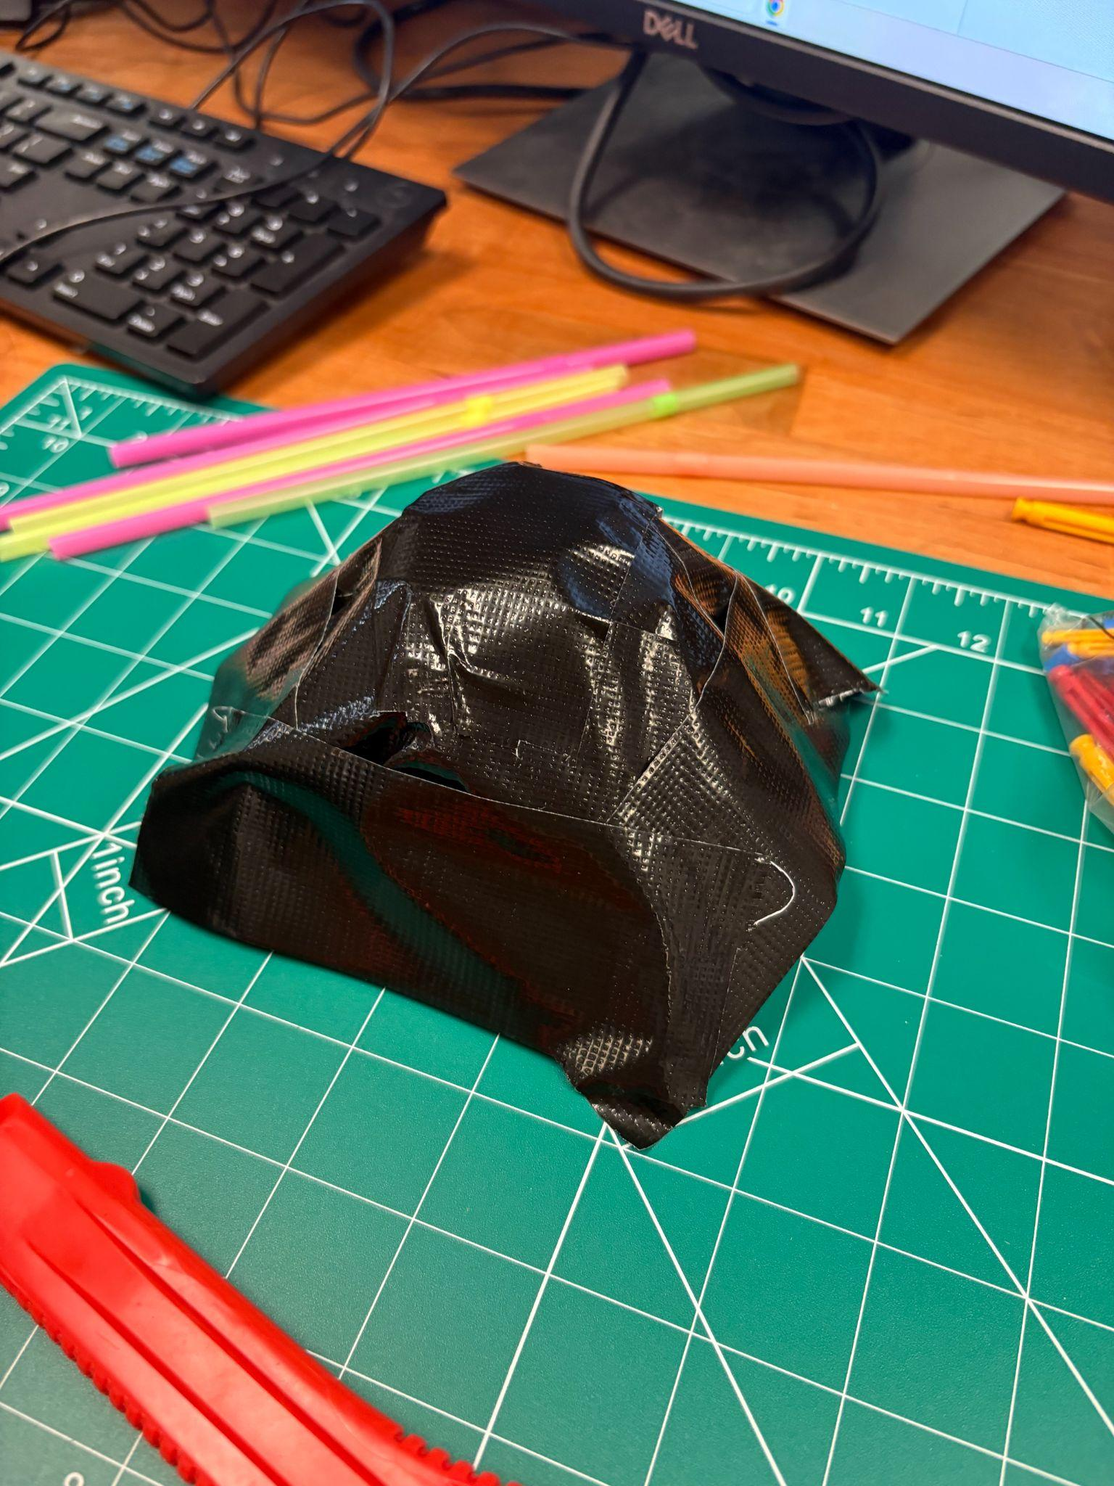
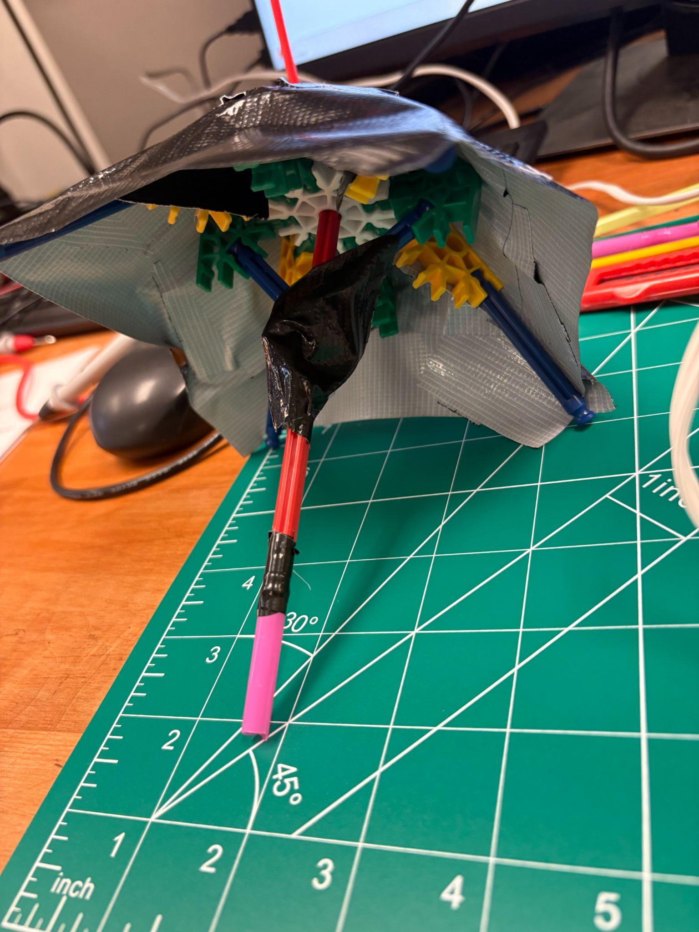
Stages of Prototype
Pictured above is early stage prototype
Pictured above is middle stage prototype
Pictured above is final stages prototype
Notes:
Sam

Slide 8
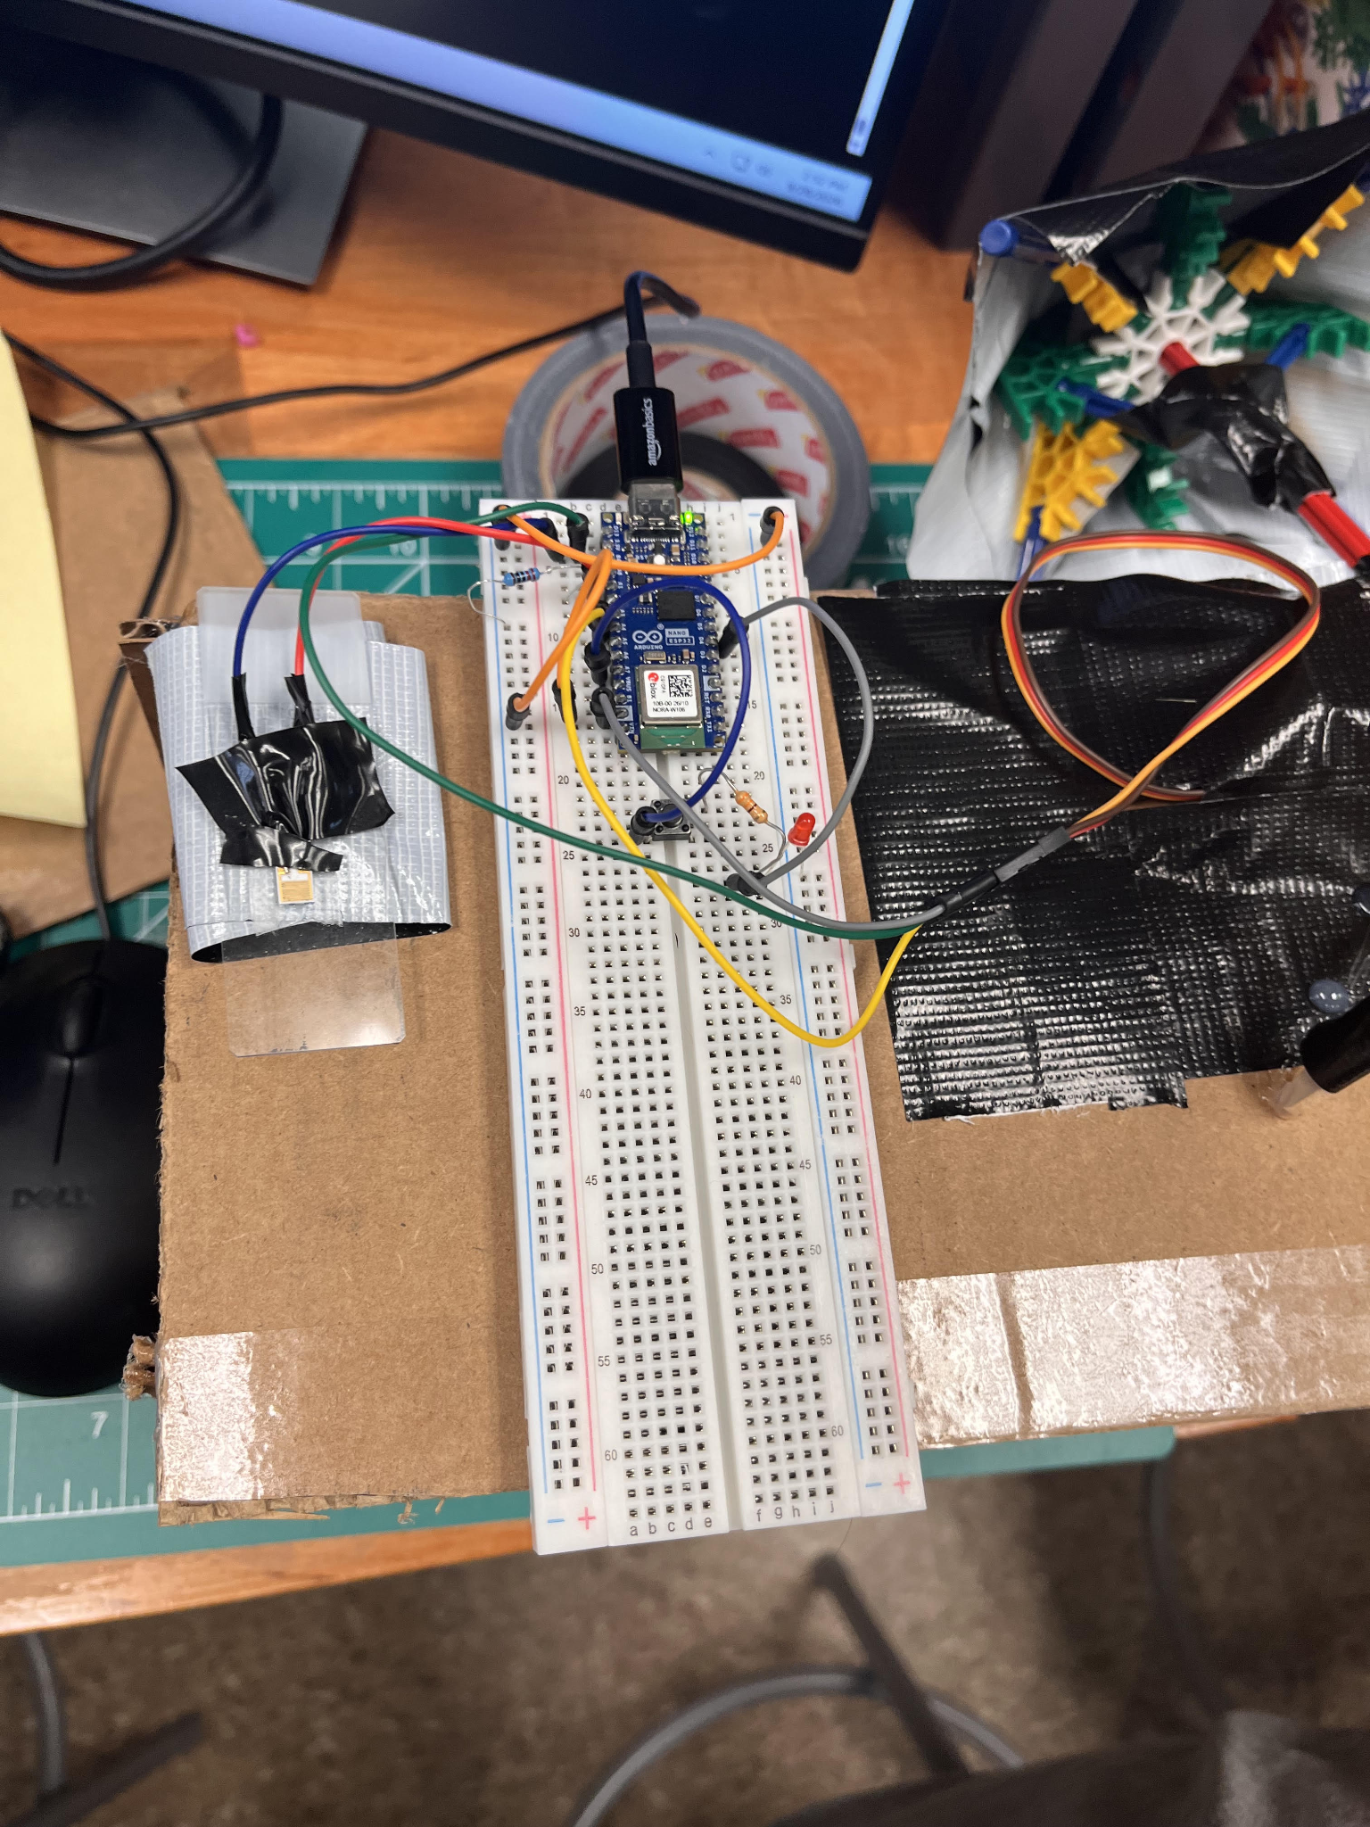
Implementation of Wiring & Coding
Connections
Pins
Humidity sensor (A1)
Red LED (D4)
Contact Switch (A7)
Servo Motor (A4)
Pictured Above is Prototype
Notes:
Brandon
Grey wire is connected to ground wire. (motor)
Green wire is connected to power wire. (motor)
Yellow is connected to signal wire (motor)
Blue wire is connected to negative side.
Red is connected to positive side.
Blue wire connects contact switch to A7.

Slide 9
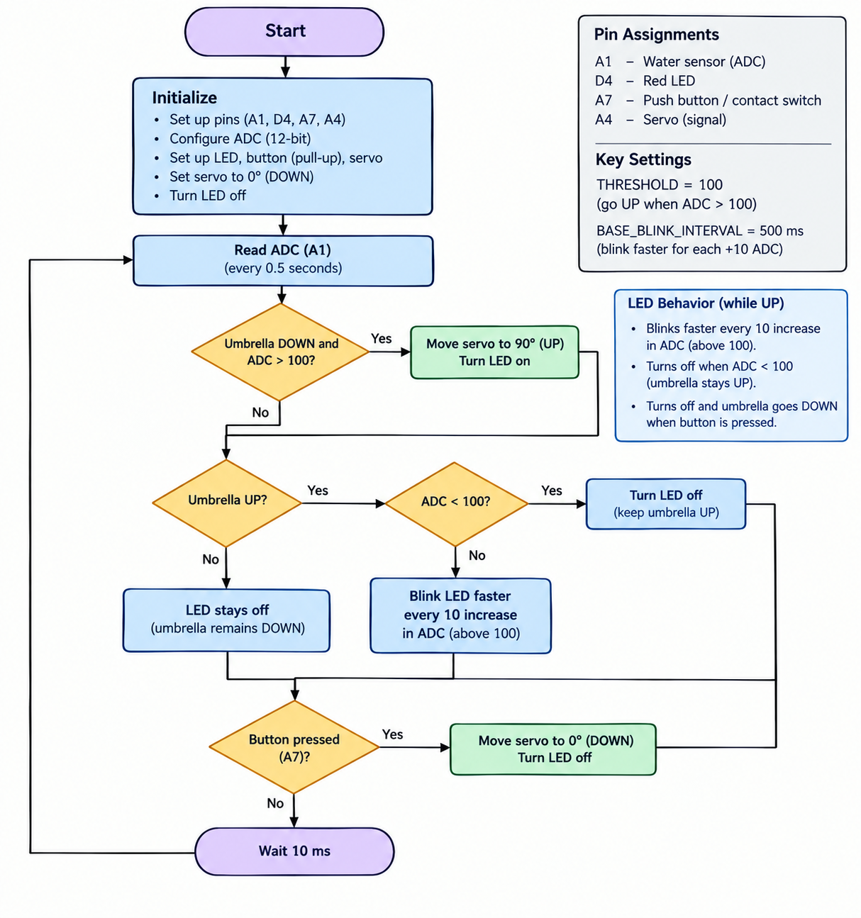
Flow
Chart
Notes:
Micah

Slide 10

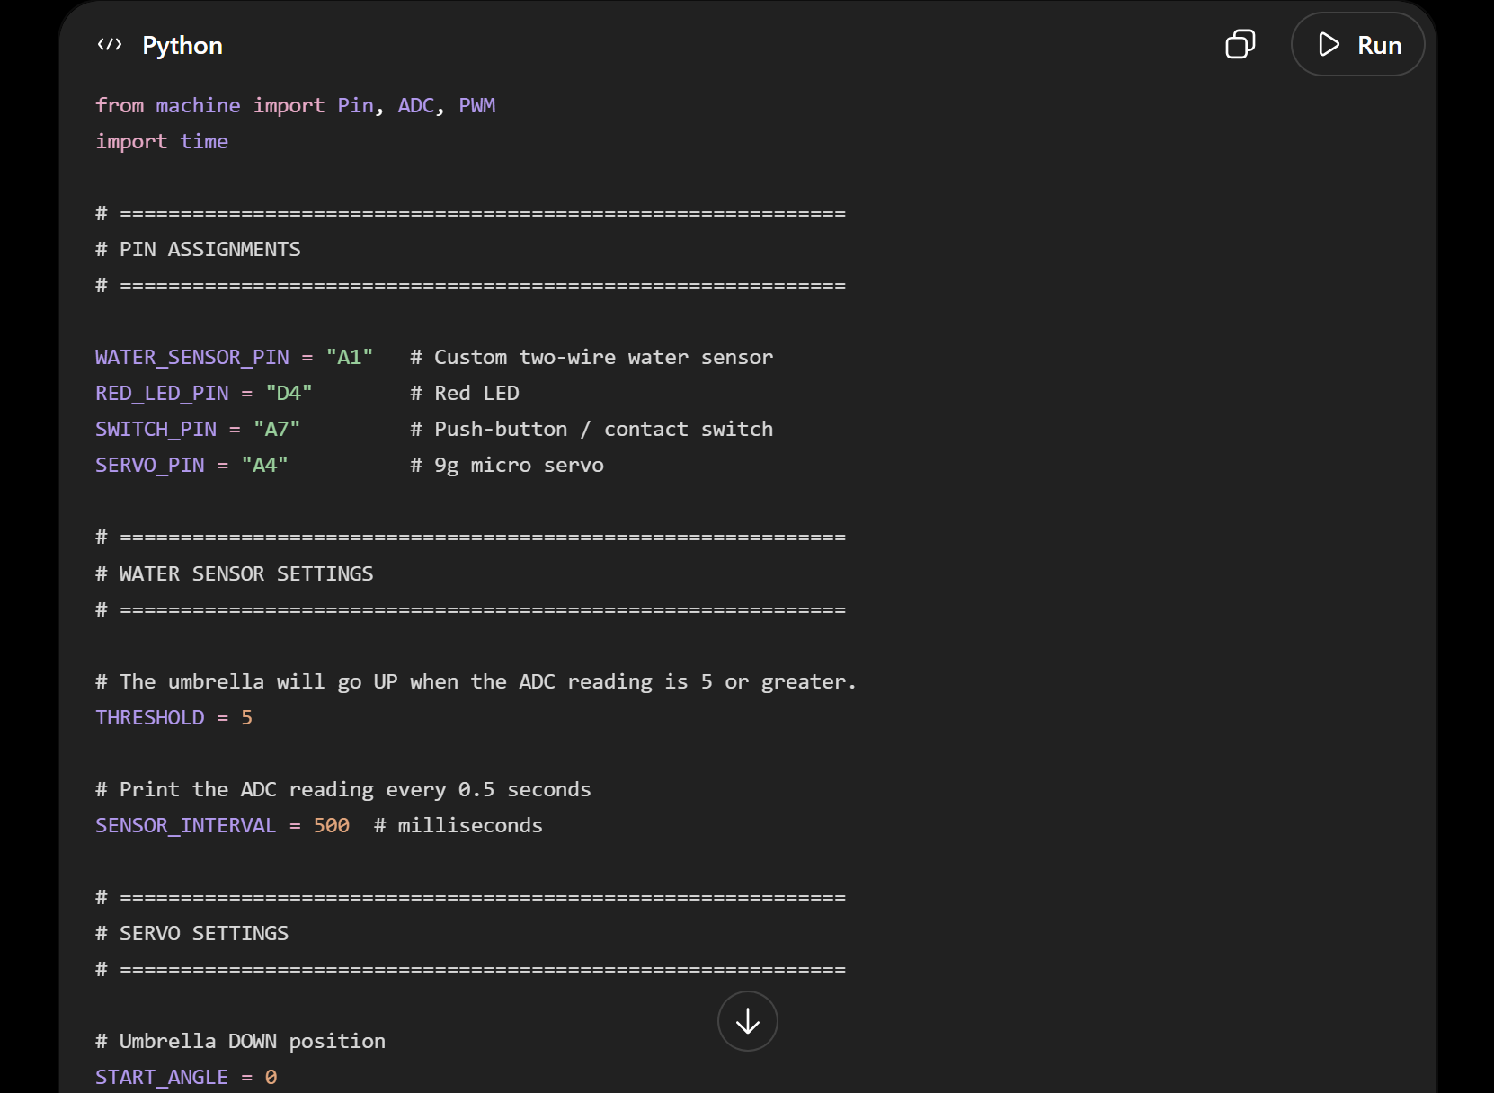
AI Usage
Creating the Code
Breadboard Setup Assistance
Revising the Code
Notes:
Micah
We crafted our ChatGPT prompt by looking back at the prompt template from previous classes. Then, we wrote down all of the actions we want the code to create and all of the pins that each component of the circuit are connected to. Then, we tested the code and realized that a part of our circuit was not connected correctly. So we told ChatGPT the problem and it explained how to fix the wiring of the Servo motor so everything worked correctly. Then, we gave the AI another prompt to revise our design and make the LED light a more functional part of our system. We also had to adjust the ADC reading threshold which was an easy fix after telling ChatPGT what we wanted.

Slide 11

Results
Sensor Input
Motor Output
LED Output
Manual Off Switch
Notes:
Brandon
The sensor correctly identified the moisture in the air, activating the system
The motor functions as intended, rotating the Umbrella upward when given the signal
The LED flashing speed varies as the ADC increases or decreases
The switch utilized always the user to switch off the umbrella when they wish

Slide 12

Conclusion
Demonstration Video:
Accomplishments
Successfully created a functioning umbrella that opens automatically using one sensor and closes using another sensor.
Functionality
Umbrella shielded the test subject.
Notes:
Micah

